Slide 1

Explainability Pipeline for Spatiotemporal Land Surface Forecasting Models
M.S. Research Presentation on
Tushar Verma (2022AIY7514), ScAI, IIT Delhi
Supervisor: Prof. Sudipan Saha

Slide 2
Clarifying the Meaning of Spatiotemporal Data
In remote sensing spatiotemporal data is often taken as just geotagged time-series readings.
In computer vision, and satellite imagery, spatiotemporal data commonly refers to a sequence of images (or video frames) captured over time. Each frame contains spatial information (like patterns, textures, or structures).
In this research, we focus on explaining models that work with this second type of spatiotemporal data.

Slide 3
Motivation
Challenges in Model Explainability
High-dimensional spatiotemporal feature spaces complicates model interpretation.
Advanced models (e.g., ConvLSTMs) are often black boxes, making results hard to interpret.
Traditional XAI techniques may not scale well for high-dimentional datasets.
The Need for Explainable AI in Climate Studies
Identifying key meteorological drivers influencing terrestrial surface.
Ensuring transparency and trustworthiness in forecasting models is crucial.
Explainability can enhance our understanding of climate dynamics.

Slide 4
Literature Review
While there are NO standardized explainability techniques specifically designed for spatiotemporal models, explainable AI (XAI) for spatiotemporal models is an emerging field of research.
Many of the techniques focus on creating an interpretable model tailored to a given dataset, rather than taking a model-agnostic approach.
Traditional XAI Methods for Evaluating Global Feature Importance
Permutation Importance Measure with P-values: Enhances the traditional permutation importance technique by adding significance testing (p-values) to it. Addresses the randomness and potential bias in standard permutation importance.
Compute Observed Importance using traditional PI
Randomly Permute the Target Vector
Compute Null Importances
Calculate p-values

Slide 5
Literature Review
Traditional XAI Methods for Evaluating Global Feature Importance
Concept Bottleneck Models (CBM): Class of explainable models that introduce an explicit intermediate layer representing human-understandable concepts.
Concept Learning
Prediction from Concepts
SHapley Additive exPlanations (SHAP): Game-theoretic approach to explain the output of machine learning models by assigning an importance value to each feature.
Establish the Baseline (Expected Value)
Generate All Possible Feature Subset
Compute Marginal Contributions
Average Over All Subsets
Sum of SHAP Values = Prediction Shift

Slide 6
Issues With The Traditional Explainability Techniques
Traditional XAI methods are not well-suited for spatiotemporal models (unapplicable)
Unrealistic Perturbations: PIMP, TIME, etc., disrupt spatial/temporal coherence, creating phantom samples and high overhead.
Weak Global Explanations: SHAP and TimeSHAP aggregate local attributions, often missing broader patterns and dependencies.
Architecture & Domain Limits: Methods like CBM or TSEM rely on predefined concepts or specific architectures, limiting generalizability.
High Computational Cost: Repeated perturbations over large spatiotemporal inputs make SHAP-like methods inefficient..

Slide 7
Key Insights from Literature
High-dimensional perturbation XAI method would be computationally impractical.
A more feasible solution is dimensionality reduction before applying perturbations.
Down-sampled samples should be interpretable. This enables meaningful perturbations.
Samples should be up-sampled back to the full spatiotemporal format.
Computationally manageable.

Slide 8
Methodology Overview
The Cluster-Segregate-Perturb (CSP)
First down-sample high-dimensional spatiotemporal features into interpretable temporal signals using feature disentanglement techniques like β-VAE.
Next, it applies clustering to identify patterns and partitions the data through segregation, ensuring that feature importance can be assessed locally before being aggregated globally.
Finally, controlled perturbations are introduced at the latent feature level, allowing for meaningful analysis while preserving spatiotemporal coherence.

Slide 9
CSP Pipeline (Interpretability Throughout)
Downsampling

Slide 10
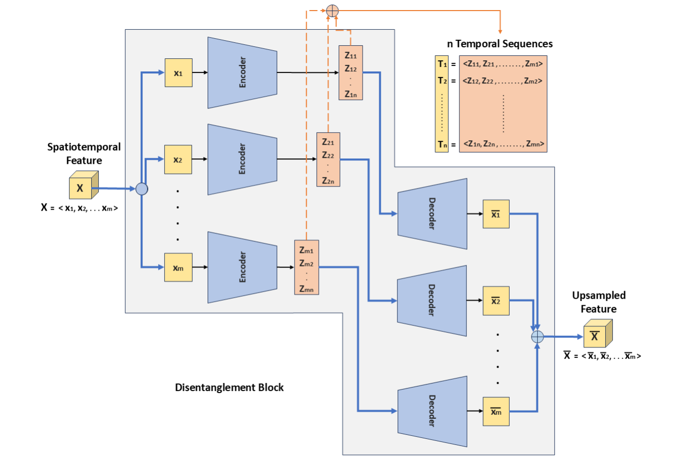
Illustrates the disentanglement block for a spatiotemporal feature, all the encoders share weights similarly all the decoders share weights

Slide 11
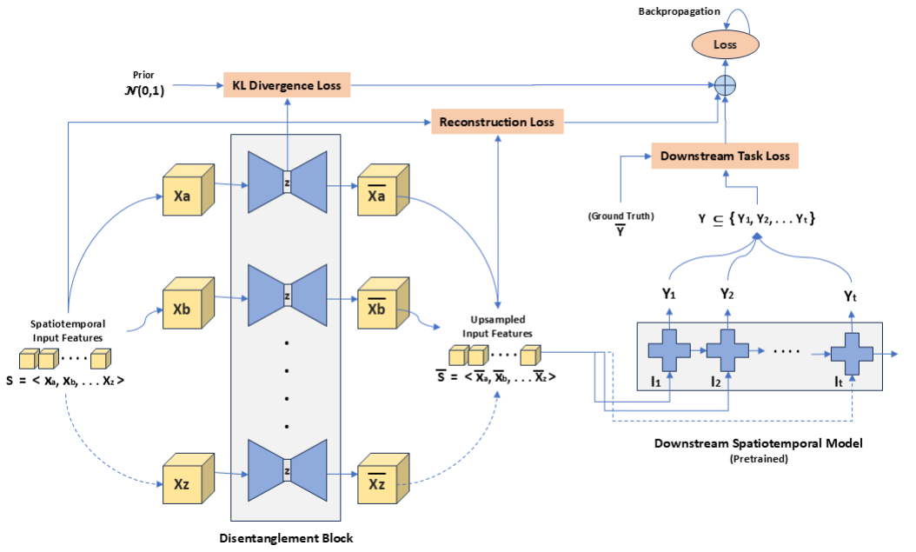
Illustrates the training process of disentanglement block(s)

Slide 12
CSP Pipeline (Interpretability Throughout)
Clustering

Slide 13
Aim of Clustering
Down-sampling process results in a set of temporal features.
Identifying distinct temporal trends within down-sampled features.
Leveraging well-established signal processing techniques to effectively preprocess and cluster these features.

Slide 14
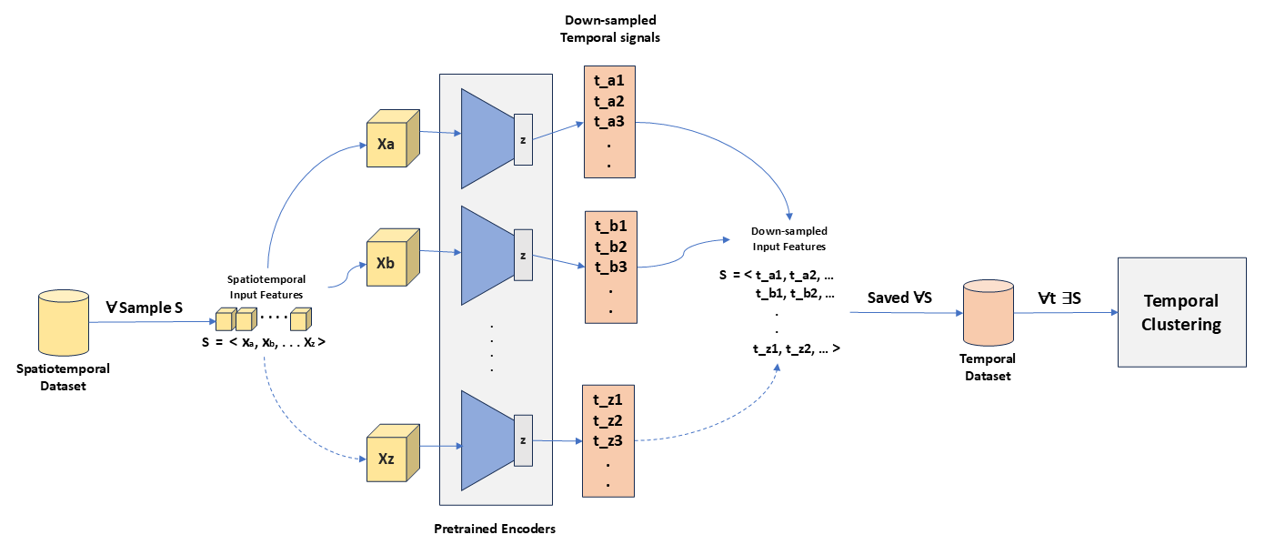

Slide 15
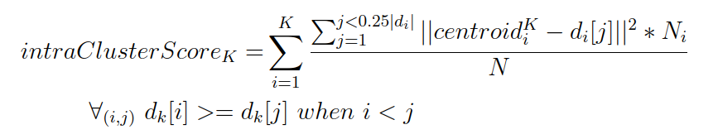
Cluster Evaluation
To evaluate the quality of the clustering, we devised two complementary metrics:
IntraClusterScore (Cohesion) : Highlights the top 25% worst-performing samples in each cluster.
InterCentroidScore (Separation) : Quantifies the smallest separation between clusters, offering a worst-case perspective on the distinctiveness of the clustering

Slide 16
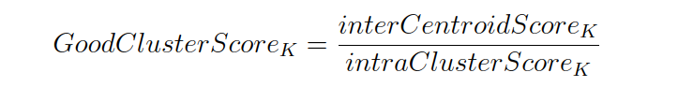
Cluster Evaluation
GoodClusterScore : combines the intra-cluster and inter-cluster metrics to provide an overall assessment of the clustering quality.
A High GoodClusterScore indicates well-defined clusters, where the samples within each cluster are tightly grouped around their centroid, simultaneously, the clusters are well-separated and distinct, signifying minimal overlap.
* Log(K)

Slide 17
CSP Pipeline (Interpretability Throughout)
Segregation

Slide 18
Aim of Segregation
Partitioning the dataset into meaningful segments.
Temporal features within each segment should exhibit similar trends.
Crucial for evaluating robust feature importance at a granular level, which can then be aggregated in an informed manner to provide global values.

Slide 19
Ways of Segregation
Clustering-Based Recursive Segmentation (drawing parallels with decision tree methodologies).
External Metadata-Based Segmentation (e.g., geolocation, climate type, sea level, population density).

Slide 20
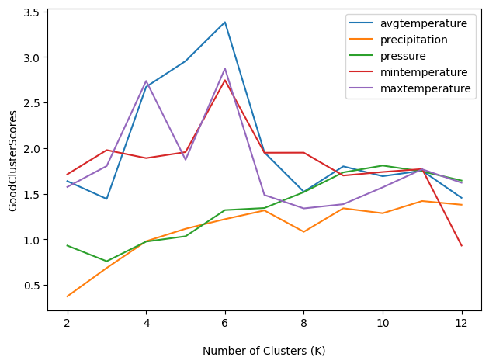
Discriminative Power of GoodClusterScore (GCS)
Comparing the GCS of different temporal features helps in identifying which feature can divide the dataset into cohesive and distinct groups more efficiently.
A higher GoodClusterScore indicates well-separated, tightly packed clusters, implying high discriminability.
A lower value suggests overlapping or loosely structured clusters, meaning the features lack discriminative power.

Slide 21
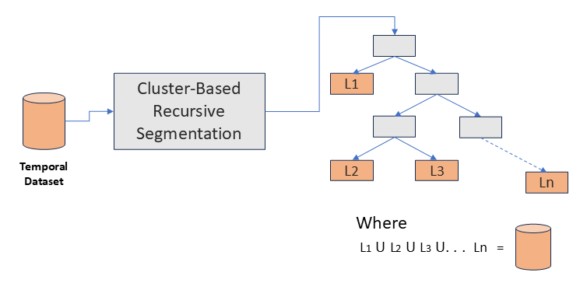
Clustering-Based Recursive Segmentation
Clustering-Based Recursive Segmentation mirrors decision tree construction.
Replaces entropy-based splits with clustering-driven GoodClusterScore (GCS).
At each step, temporal features are clustered, and the feature yielding the highest GoodClusterScore (GCS) is selected for splitting.
The process stops when no feature produces a GCS above a defined threshold, preventing over-segmentation and preserving interpretability.

Slide 22
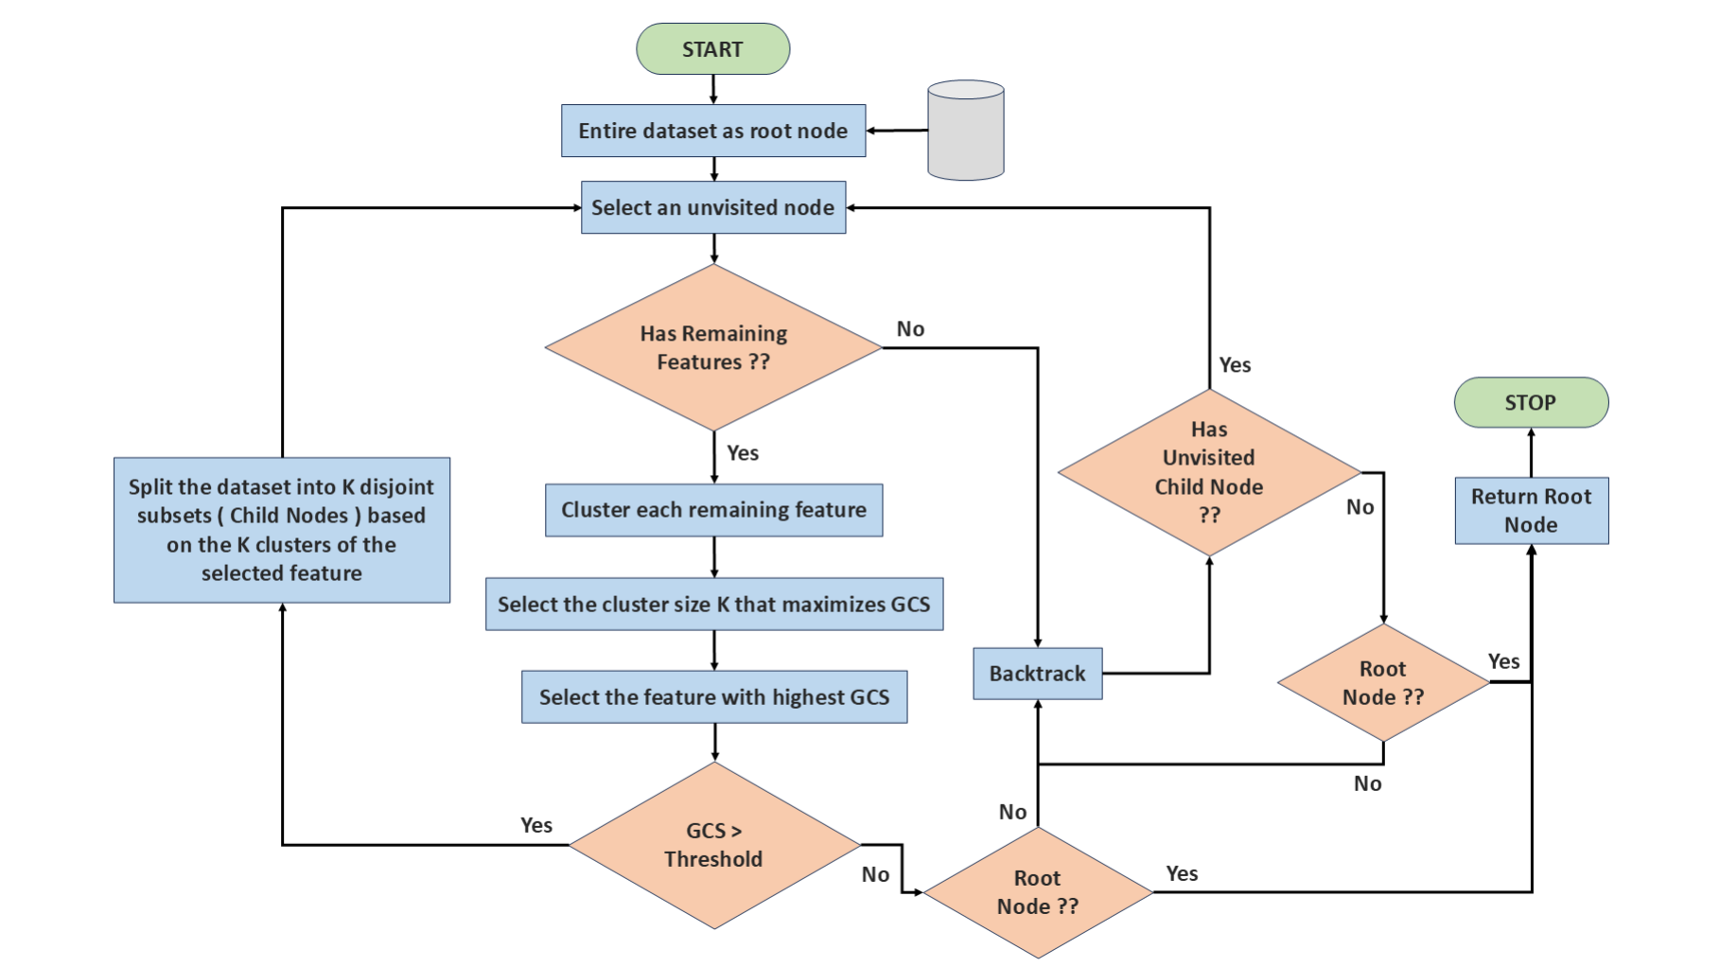

Slide 23
CSP Pipeline (Interpretability Throughout)
Perturbation

Slide 24
Aim of Perturbation
Makes explainability more robust within a given local region (segment) of dataset.
Perturbations should preserve spatiotemporal coherence.
Overcome computational limitations of traditional perturbation-based XAI methods in handling high-dimensional spatiotemporal data.

Slide 25
Meaningful Perturbations with Feature Disentanglement
Enable smooth and interpretable perturbations in a continuous latent space. Ex z = N(0,1)
Allow structured and consistent changes in reconstructed data post-perturbation.
Preserve spatiotemporal coherence during perturbations.
Representing spatiotemporal features as sequences of temporal features (rather than single scalars) allows for controlled perturbations for individual timestep when up-sampling.

Slide 26
Case Study

Slide 27
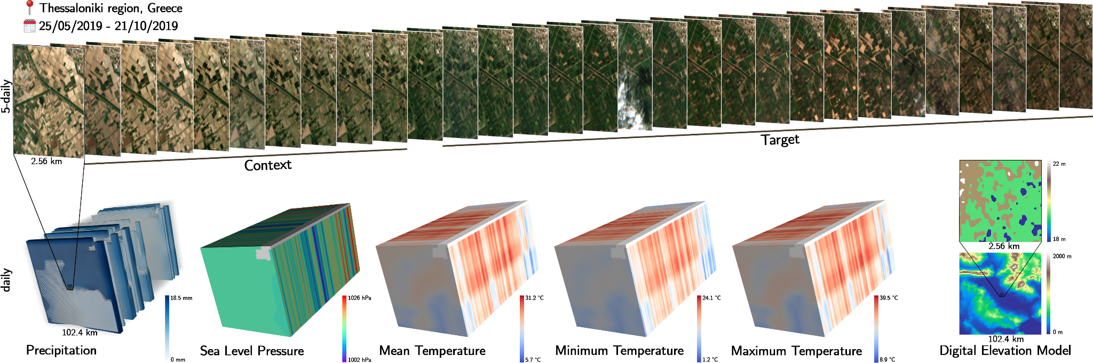
Dataset
EarthNet2021 Dataset:
EarthNet2021 is a large-scale dataset and challenge for Earth surface forecasting,which involves predicting satellite imagery conditioned on future weather.
The Dataset consists of 32,000 samples within the European region,
Each comprising a series of 30 Sentinel-2 images, each captured at intervals of 5 days.
Contain four bands (red, green, blue, and near-infrared)
Moreover, accompanying weather-related meteorological data is included, such as precipitation, sea level pressure, and temperature(minimum, maximum, and mean), each comprising a series of 150 images for 150 days.

Slide 28
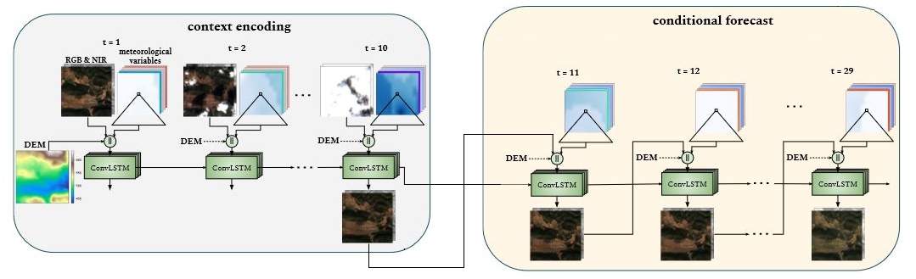
Model Architecture
ConvLSTM: We trained the model on the IID (In-Domain) split of the EarthNet2021 dataset for 60 epochs. During this training phase, we attained an EarthNetScore of 0.3287 (Very close to SOTA performance)

Slide 29
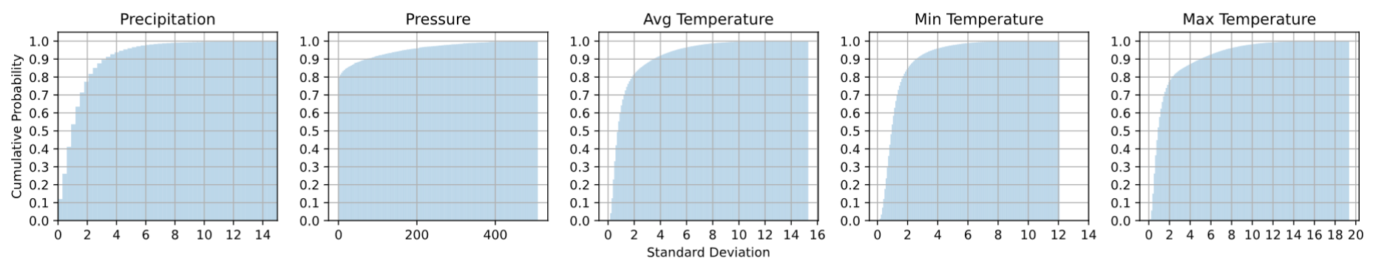
Downsample Spatiotemporal Features
For the EarthNet21 dataset, each sample represents a small geographical area of just 2.56 km², making it an ideal candidate for variability analysis as smaller areas are less likely to exhibit significant spatial heterogeneity, for meteorological variables like temperature, pressure, precipitation.
Due to low to Moderate spatial variability, we opted to downsample the meteorological variables to a single average value per timestep.

Slide 30
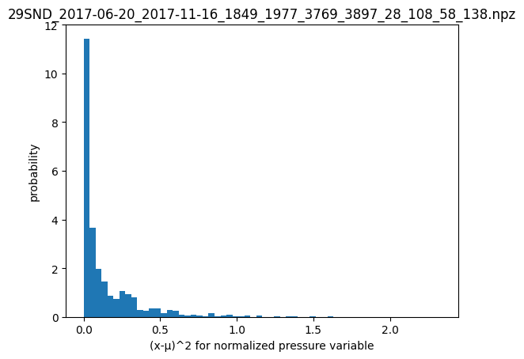
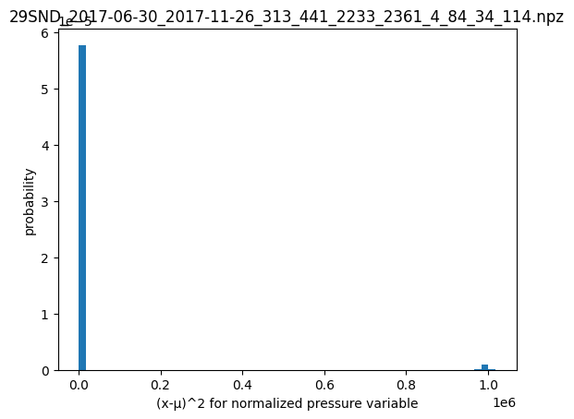
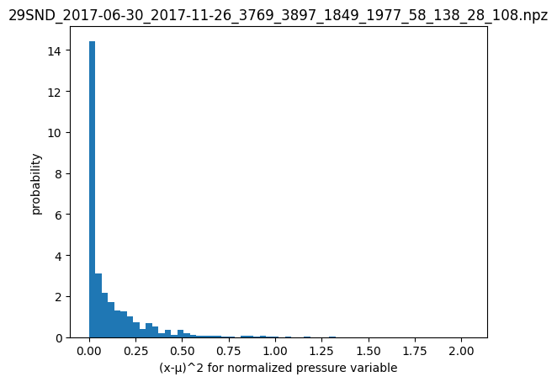
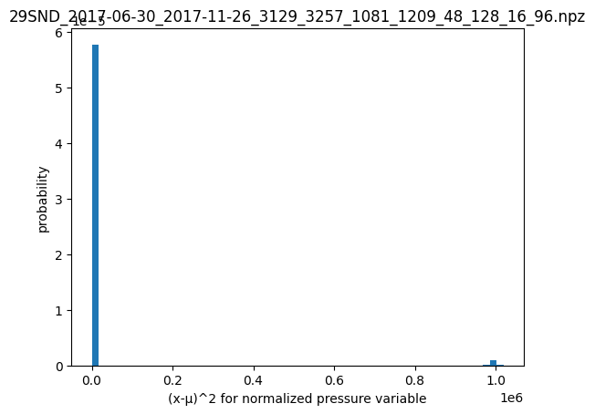
Outliers
in
data

Slide 31
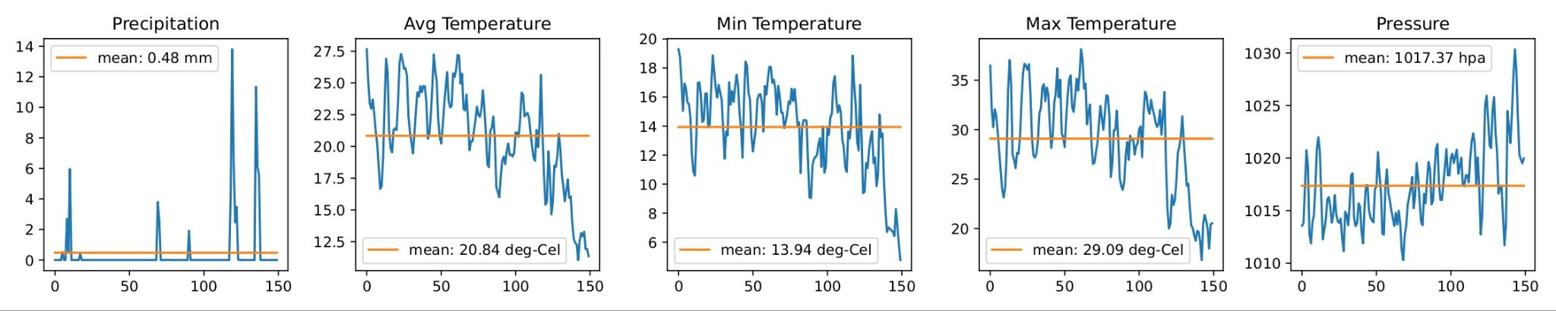
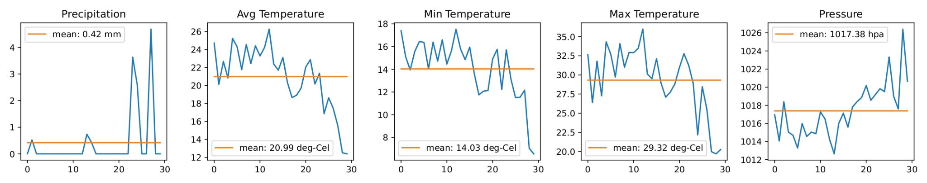
Preprocessing
To harmonize the temporal resolution of the mesovariables with the Sentinel-2 images, we aggregated the mesovariables into 5-day intervals. Precipitation values were summed over each 5-day period, while temperature and pressure values were averaged.

Slide 32
Clustering-Based Recursive Segmentation

Slide 33
Clustering the Meteorological Variables
Clustering Techniques:
We standardized the time series using min-max normalization and applied Gaussian smoothing with a gamma value of 1.1 to highlight the underlying trends.
To identify the most effective approach, we experimented with four distinct techniques:
K-means clustering with Euclidean distance as the metric, focusing on straight forward spatial proximity.
K-means clustering with Dynamic Time Warping (DTW), capturing temporal alignments and accounting for time shifts.
K-means clustering with Soft-Dynamic Time Warping (Soft-DTW), introducing a smoother variant of DTW to handle minor variations robustly.
K-shape clustering with Shape-based Distance (SBD), specifically designed to group time series based on their overall shapes and trends.

Slide 34
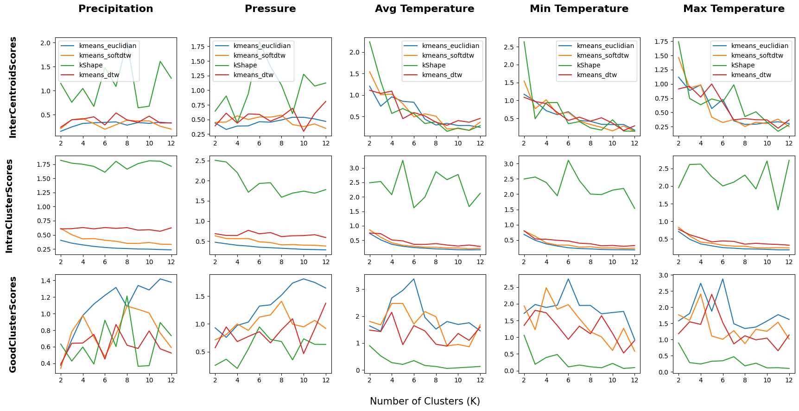

Slide 35
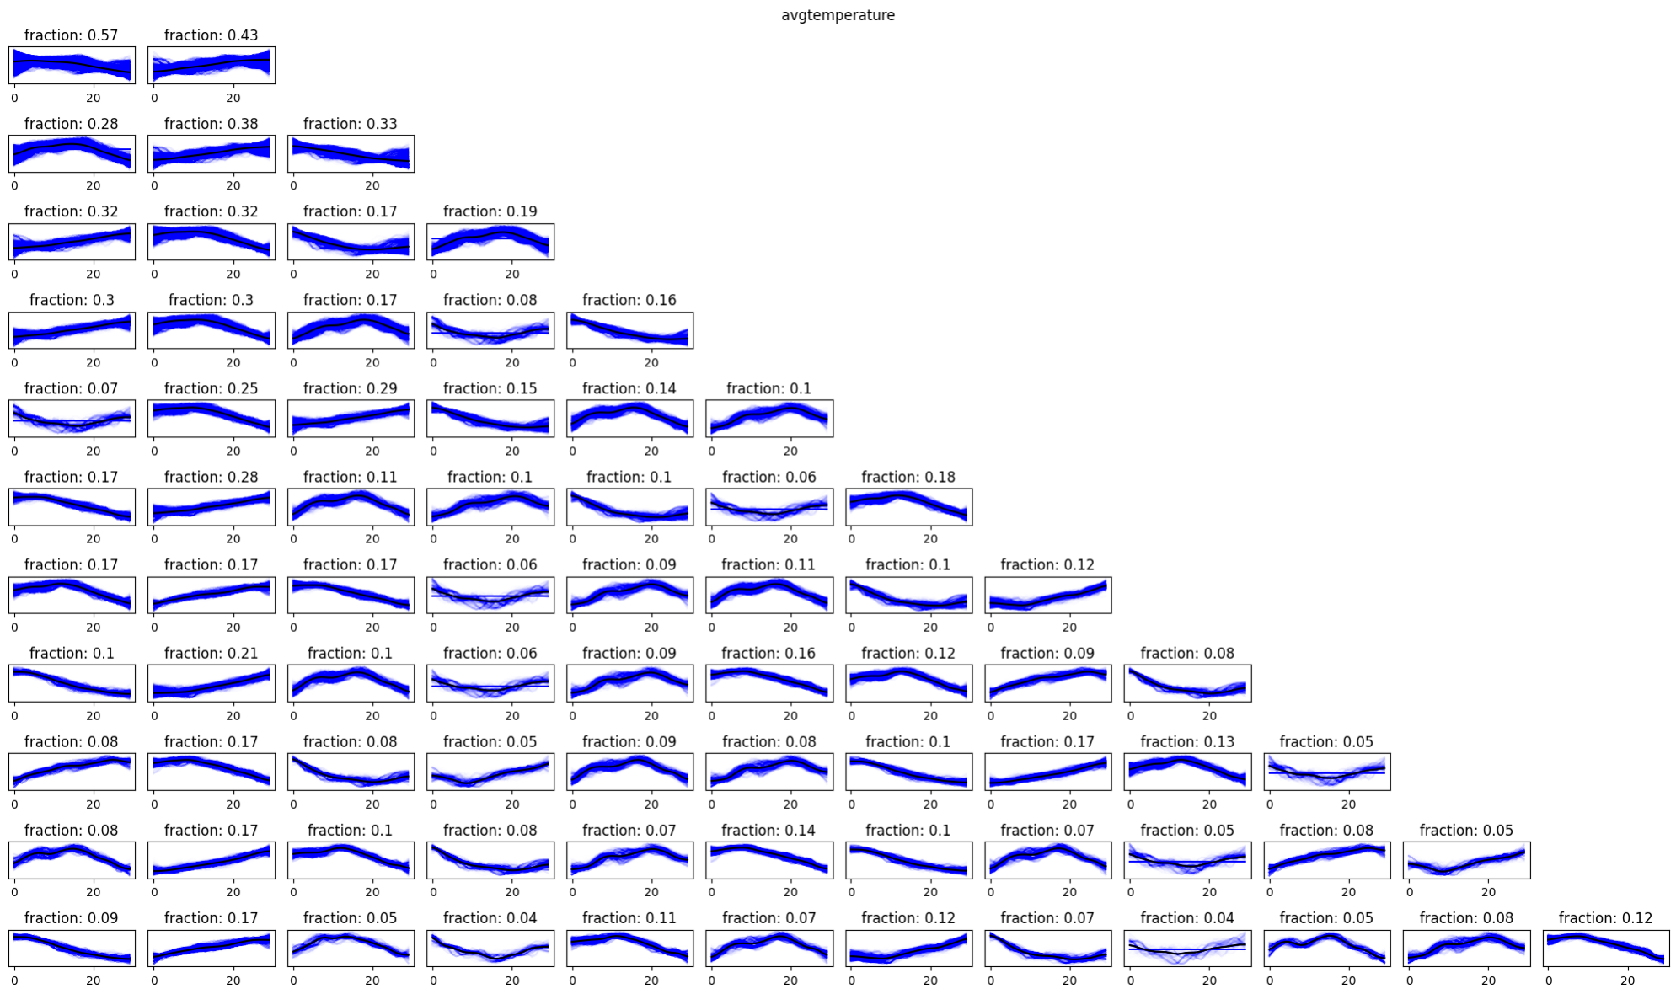
K-Means clustering with Euclidean distance
avg-temperature clusters for k = [2,12]

Slide 36
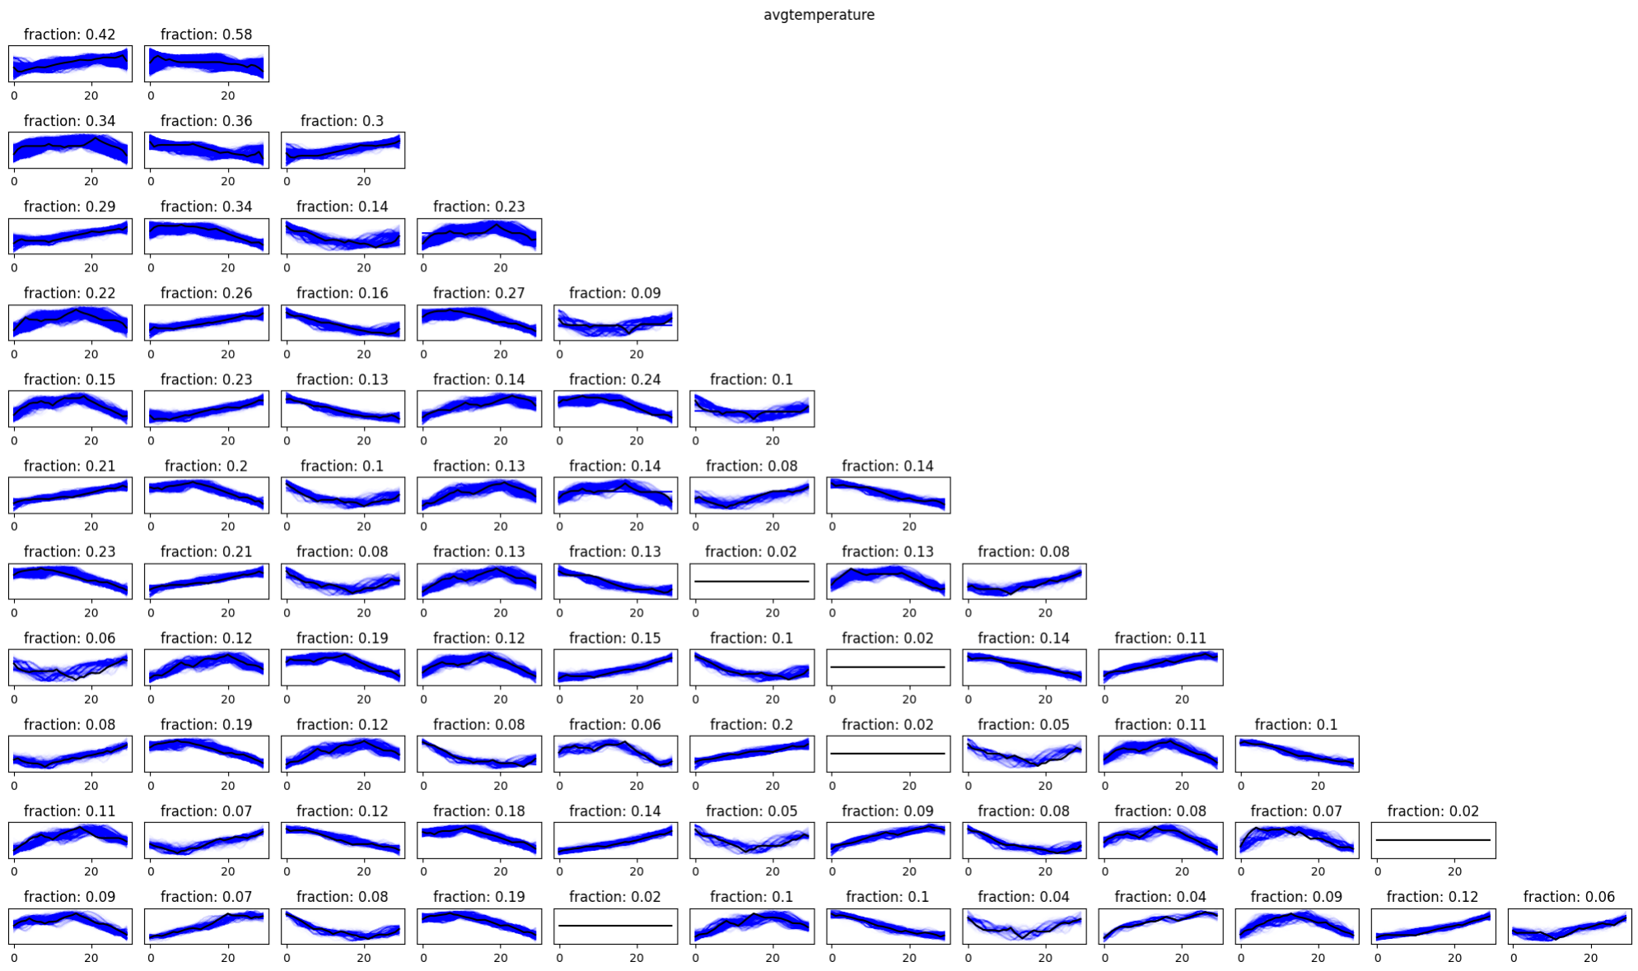
K-Means clustering with DTW
avg-temperature clusters for k = [2,12]

Slide 37
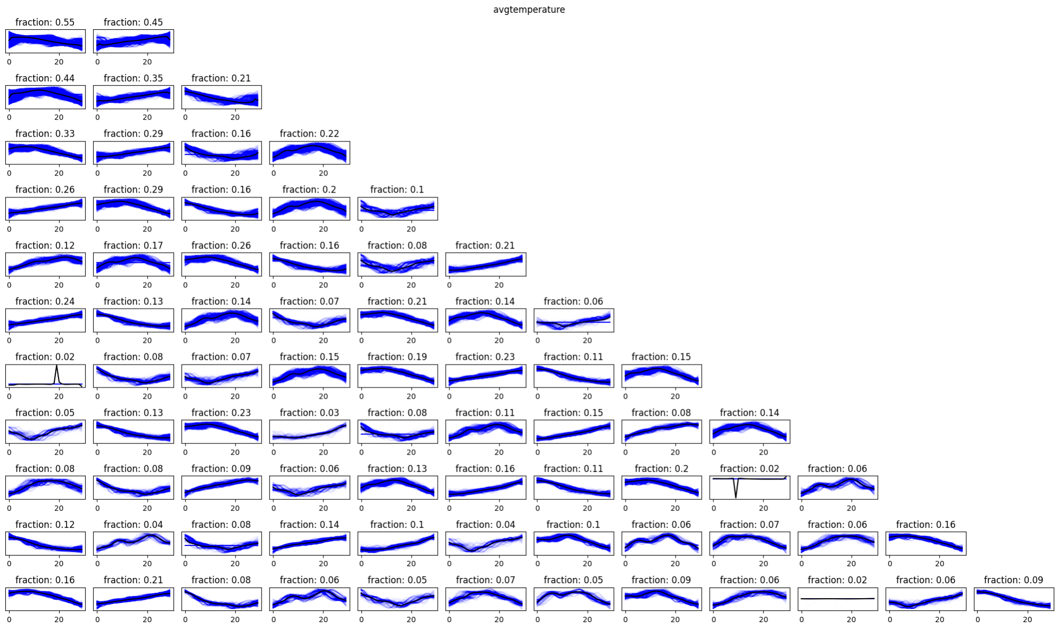
K-Means clustering with Soft-DTW
avg-temperature clusters for k = [2,12]

Slide 38
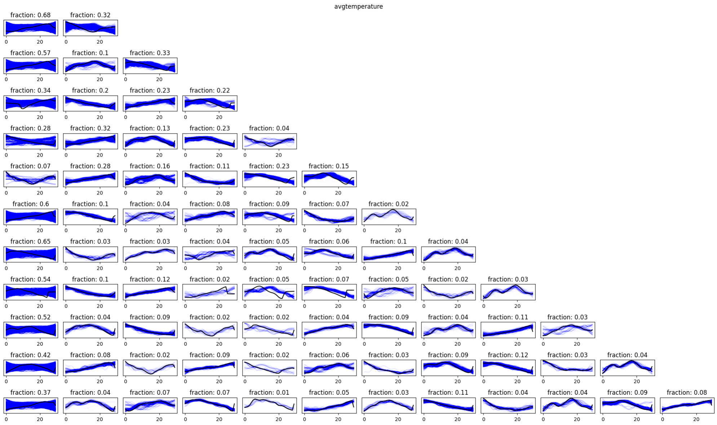
K-Shape clustering with Shape-based Distance(SBD)
avg-temperature clusters for k = [2,12]

Slide 39
Clustering the Meteorological Variables
Discriminative Analysis of the Meteorological Variables :
Scale of the GoodClusterScore also provides insights into the discriminative power of different variables.
From the chart, it is evident that temperature-related variables exhibit clear peaks around 4-6 cluster size suggesting more discriminative power compared to other variables. This suggests that temperature is significantly more effective in categorizing dataset samples into meaningful groups.
This finding is further reinforced by the observed seasonal patterns:
Temperature in Western Europe unlike precipitation and pressure, exhibits clear seasonal trends (e.g., warmer summers, colder winters) that are fairly predictable year after year.

Slide 40
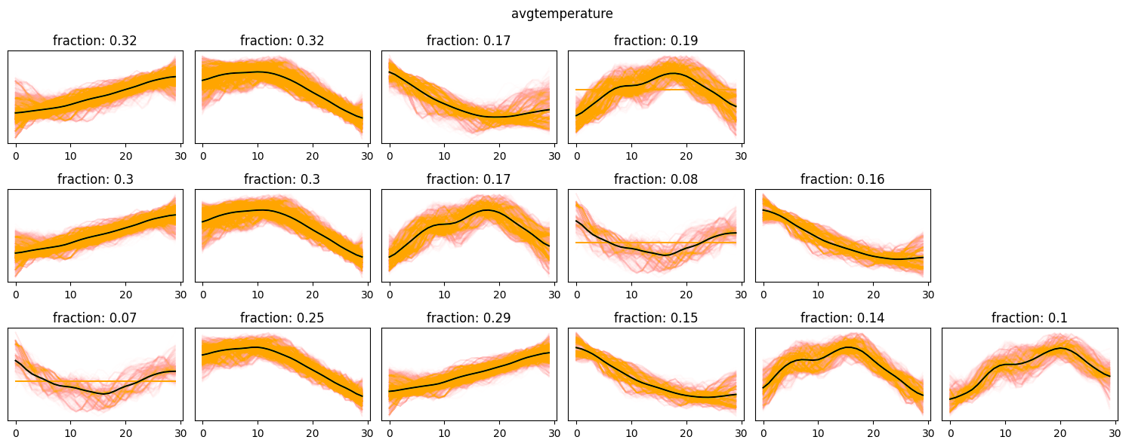
Segregation
For temperature, we discovered that the temporal cluster patterns for average, minimum, and maximum values are nearly identical. Thus, we focus solely on average temperature to select the optimal K.
K = 4, 5, 6 are strong candidates.
1
2
3
4
5
6

Slide 41
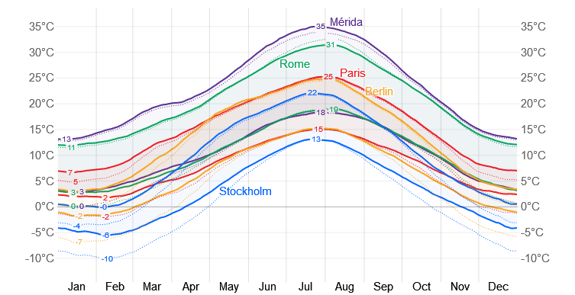
Segregation
Selecting K = 6 for its highest GoodClusterScore may initially seem appealing, however studying the temperature trends reveals a significant overlap between certain clusters which decreases the distinctiveness of the clusters.
Clusters 1 and 4 show considerable overlap in terms of months, with cluster 4 occurring only 1 to 1.5 months before cluster 1.
Clusters 5 and 6 exhibit a similar pattern, with cluster 6 preceding cluster 5 by about a month.
Comparison of the Average Weather in M´erida, Rome, Paris, Stockholm, and Berlin.
Source: WeatherSpark.com.

Slide 42
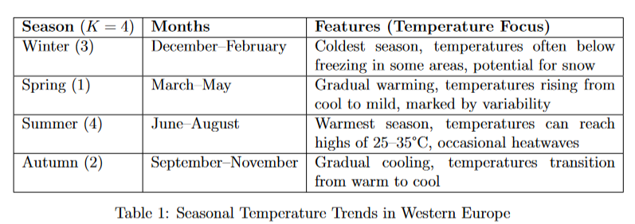
Segregation
We selected K = 4, which not only minimizes overlap but also provides clearly defined trends across the data. Furthermore, K = 4 aligns closely with the four distinct seasons defined by temperature trends in western Europe, as expressed in Table1.

Slide 43
Metadata-Based Segmentation

Slide 44
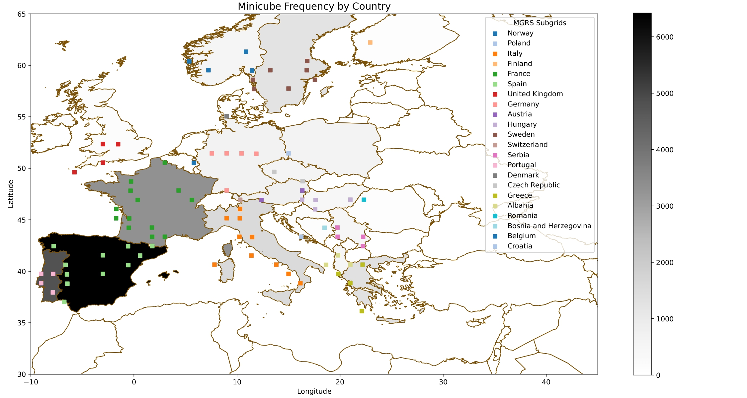
Segregation
1. Country based Categorization:
The minicubes in the EarthNet2021 dataset are organized within folders labeled according to the MGRS (Military Grid Reference System) subgrid.
For example, a folder named ’29SND’ represents a Sentinel-2 tile located at longitude 29° and latitude South, within the ND subquadrant (100 km x 100 km). This systematic arrangement enables precise localization of each MGRS subgrid on the map, along with identifying its country of origin

Slide 45
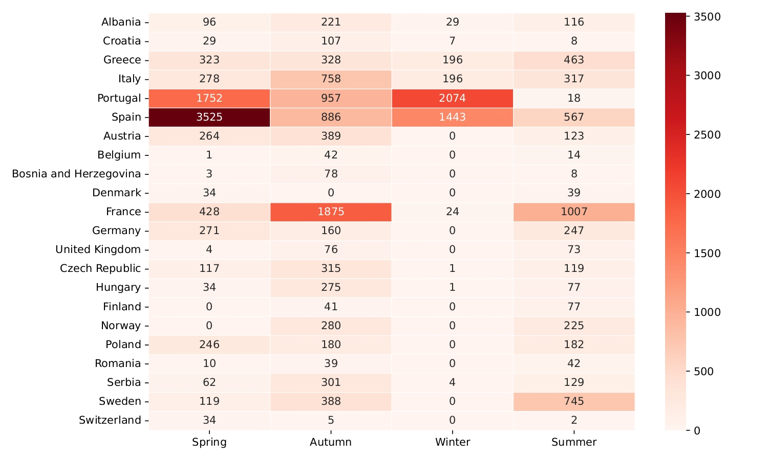
Segregation
1. Country based Categorization:
Country boundaries are artificial constructs and do not necessarily align with natural geographic or climatic divisions. For instance, in a large country with two minicubes located far apart, the weather patterns and scenes they represent could differ significantly.
This highlights the need for a more generalized and climate-aware segmentation approach.

Slide 46
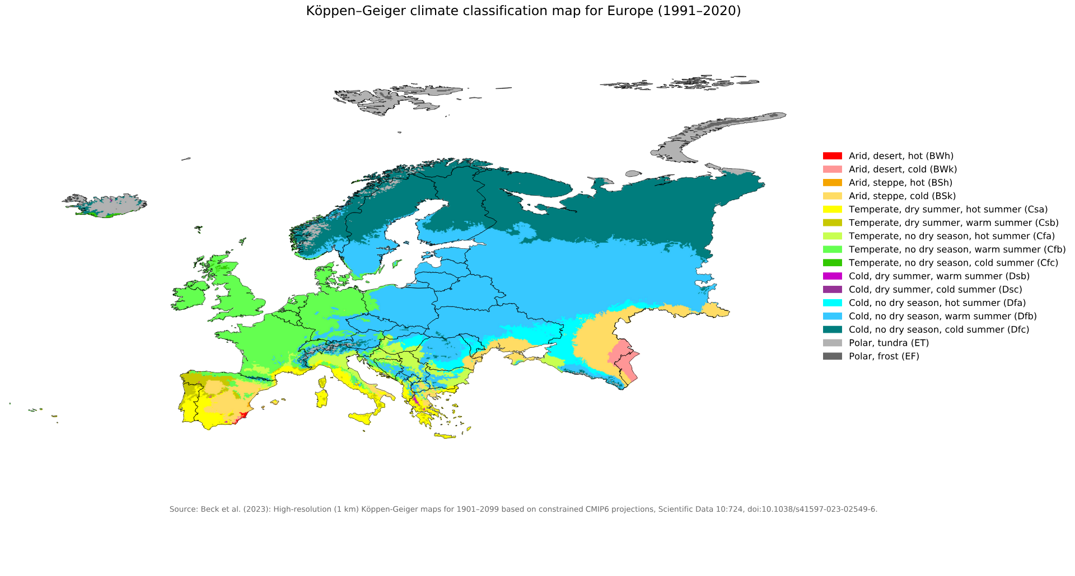
Segregation
2. Köppen Climate based Categorization:
Divides climates into five primary types, each represented by a letter:
A – Tropical, warm temperatures year-round and heavy rainfall.
B – Arid (Dry), very little precipitation, including deserts and steppes.
C – Temperate, mild temperatures and moderate seasonal changes.
D – Continental, large temperature variations and cold winters.
E – Polar, extremely cold temperatures and minimal precipitation.
The Köppen climate classification is a widely used system for classifying the Earth’s climates based on temperature and precipitation patterns. Developed by the German climatologist Wladimir Köppen in 1884, it

Slide 47
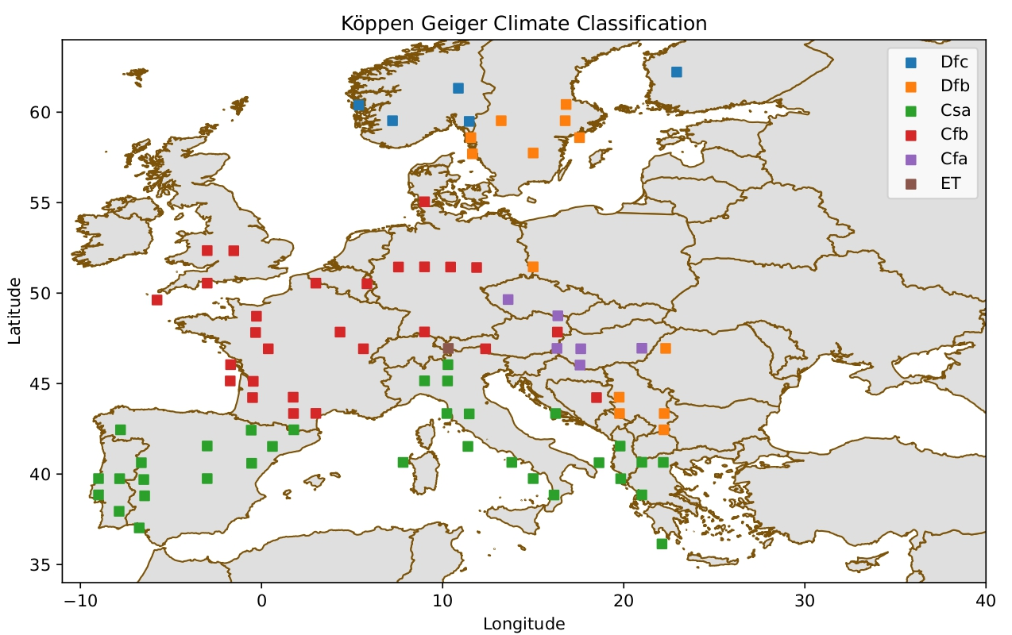
Segregation
2. Köppen Climate based Categorization:
We meaningfully segmented the EarthNet21 dataset into six distinct Köppen sub-classes:
Dfc (Subarctic): Short summers, long, cold winters.
Dfb (Humid Continental): Warm summers, cold winters.
Csa (Mediterranean): Hot, dry summers; mild, wet winters.
Cfb (Temperate Oceanic): Mild summers, cool winters, with year-round rainfall.
Cfa (Humid Subtropical): Hot summers, no distinct dry season.
ET (Tundra): Extremely cold, minimal vegetation.

Slide 48
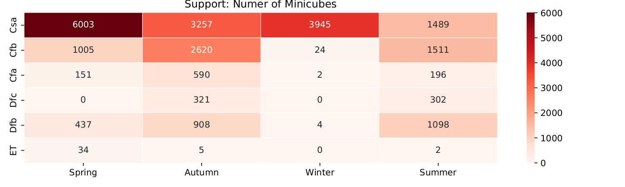
Segregation
2. Köppen Climate based Categorization:

Slide 49
Analysis
Marginal Sensitivity

Slide 50
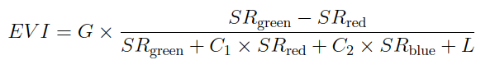
Marginal Sensitivity of Meteorological Variables on Vegetation
Vegetation Index:
We used EVI (Enhanced Vegetation index) over NDVI because it offers several advantages over traditional NDVI,.
In high-biomass regions NDVI saturates, EVI maintains sensitivity by mitigating saturation effects.
Reduces atmospheric influence.
Incorporate the blue band to correct scattering and soil background effects, ensuring greater accuracy in areas with sparse vegetation.
G is the gain factor (typically 2.5), SRgreen, SRred, and SRblue are the reflectance values for the green, red, and blue bands, C1 and C2 are coefficients for the red and blue bands (typically 6 and 7.5, respectively), L is the soil adjustment factor (typically 1)

Slide 51
Perturbation
We introduced the following perturbations to the dataset, carefully selecting values to remain within realistic bounds to ensure the integrity and validity of the resulting predictions.
Pressure: [ -6, -4, -2, 0, +2, +4, +6 ]
Temperature: [ -6, -4, -2, 0, +2, +4, +6 ]
Precipitation: [ 0, +2, +4, +6, +8, +10 ]
Perturbations were applied uniformly across the non-context window, as the context window is pairs with unmodifiable Sentinel-2 images.
The ConvLSTM model uses the first 10 timesteps as context and the next 20 for predictions.
Each meteorological variable was individually perturbed by adding a constant (+p), isolating its impact on predictions.

Slide 52
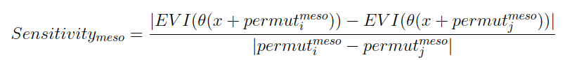
Marginal Sensitivity of Meteorological Variables on Vegetation
Procedure:
To enhance the robustness of the sensitivity analysis, we performed multiple perturbations and evaluated their interactions (pairwise combinations) on a meteorological variable. By computing the change in EVI values relative to perturbation changes, we effectively expanded the number of comparisons from n to ^{n}C₂, offering a more comprehensive view of the variable sensitivities.
where, θ is the convLSTM model, x is the input minicube, is the ith perturbation for meteorological variable meso and function EVI is computing the vegetation index

Slide 53
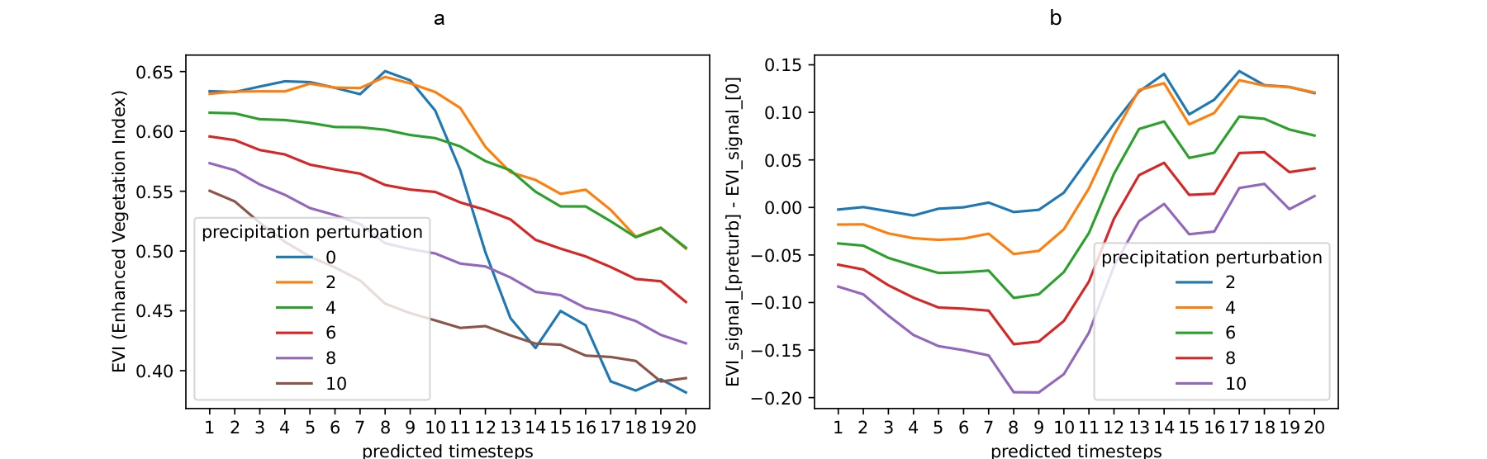
Marginal Sensitivity of Meteorological Variables on Vegetation
Challenge in aggregating timeseries sensitivities:
Evaluating sensitivity in time-series variables becomes challenging. In time-series predictions, changes in the output are influenced not only by inputs from the current timestep but also by inputs from previous timesteps. The presence of trends, rather than fluctuating values around a mean throughout the timesteps indicates that older inputs significantly contribute to the output.
a: Model’s output on precipitation based perturbations
b: Difference between the base signal and the perturbed signal

Slide 54
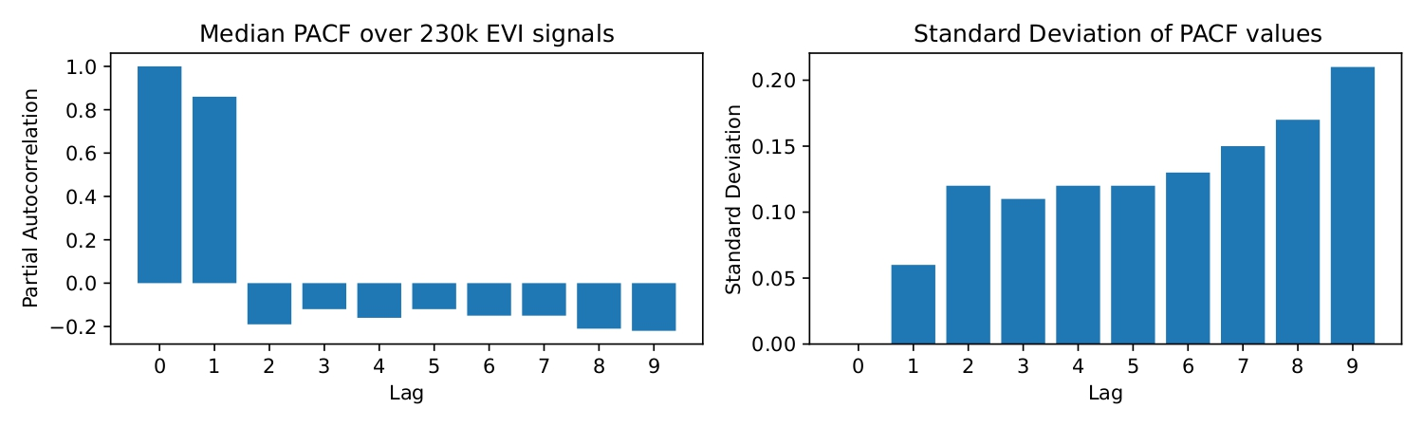
Marginal Sensitivity of Meteorological Variables on Vegetation
Analyzing Influence of Previous Timesteps:
To assess the linear influence of past EVI values on the current EVI predictions, we conducted Partial Autocorrelation Function (PACF) analysis on over 230,000 model output signals. This analysis included signals both with and without input perturbations.
The results revealed strong evidence that the model heavily relies on the immediate past timestep (lag 1) to make predictions for the current timestep, with a median PACF value of 0.8. Additionally, the standard deviation from this median was remarkably low, around 0.06, indicating consistent behaviour across the samples.

Slide 55
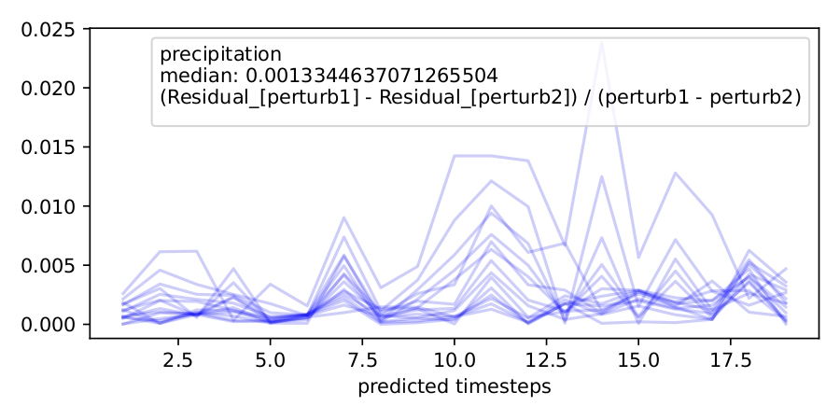
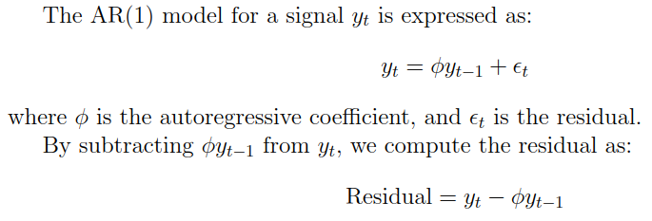
Marginal Sensitivity of Meteorological Variables on Vegetation
Removing Influences of Previous Timesteps:
Since the lag-1 timestep contributes the most to the model’s predictions, we decided to mitigate its linear influence by approximating an AR(1) model and subtracting it from the EVI signals, This operation isolates the residual, which represents variations not explained by lag-1 dependencies. The residual highlights ”current” effects, making it particularly useful in sensitivity analysis.

Slide 56
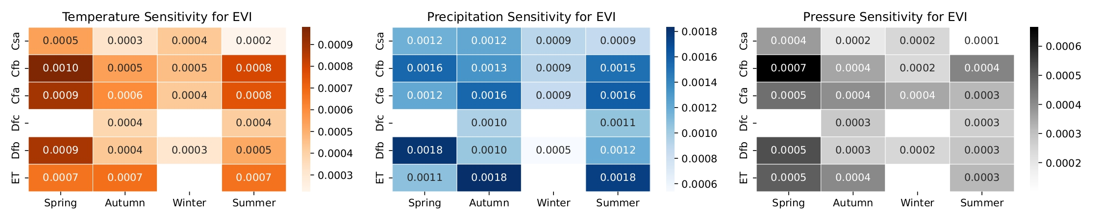
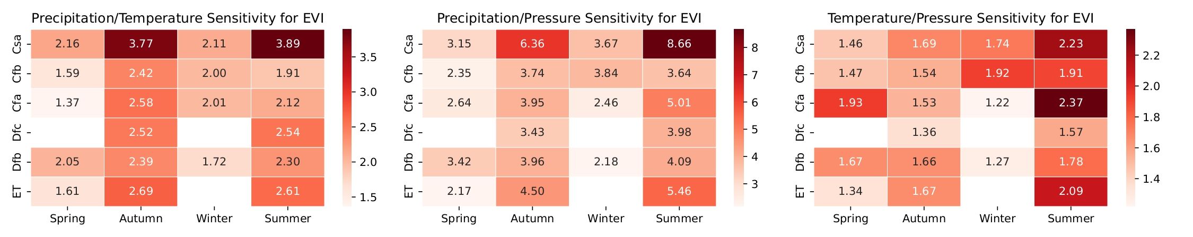
Marginal Sensitivity of Meteorological Variables on Vegetation
Results:

Slide 57
Marginal Sensitivity of Meteorological Variables on Vegetation
Overall Interpretations:
Values generally align with expectations.
Temperature: Higher sensitivity in zones with greater seasonal variability.
Pressure: Uniformly low sensitivity across all zones.
Precipitation: Dominates across all zones, reflecting its primary influence on vegetation.
Concerns:
Dfc Climate: While data scarcity limits insights, temperature sensitivity could be slightly higher in Spring and Summer to better reflect the shorter growing season in subarctic zones.
Winter Sensitivity: Slightly higher precipitation sensitivity for Cfb and Dfb in Winter could better reflect the role of snow in water availability. (limited data samples can be the potential cause)
Conclusion:
Overall, the sensitivity values demonstrate good relative alignment with the ecological and climatic characteristics of the Köppen zones.

Slide 58
Analysis
Sensitivity Correlations

Slide 59
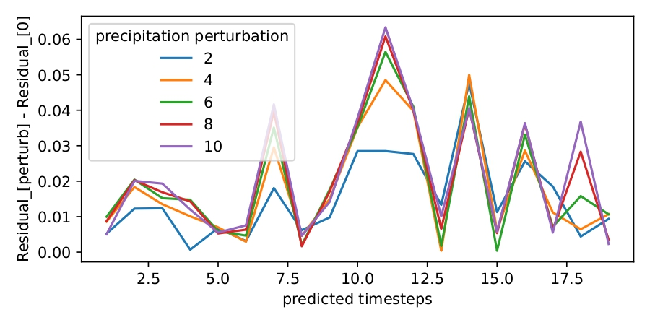
Correlation Sensitivity Curve
Looking at the difference between the increasing value of the perturbed curve and the curve with no perturbations, it is clear that sensitivity does not exhibit a linear relationship. This finding highlights the complex and non-proportional dependency of sensitivity on variations in factors such as temperature, precipitation, and pressure. Also, such insights are unattainable with random perturbations, emphasizing the need for meaningful perturbations

Slide 60
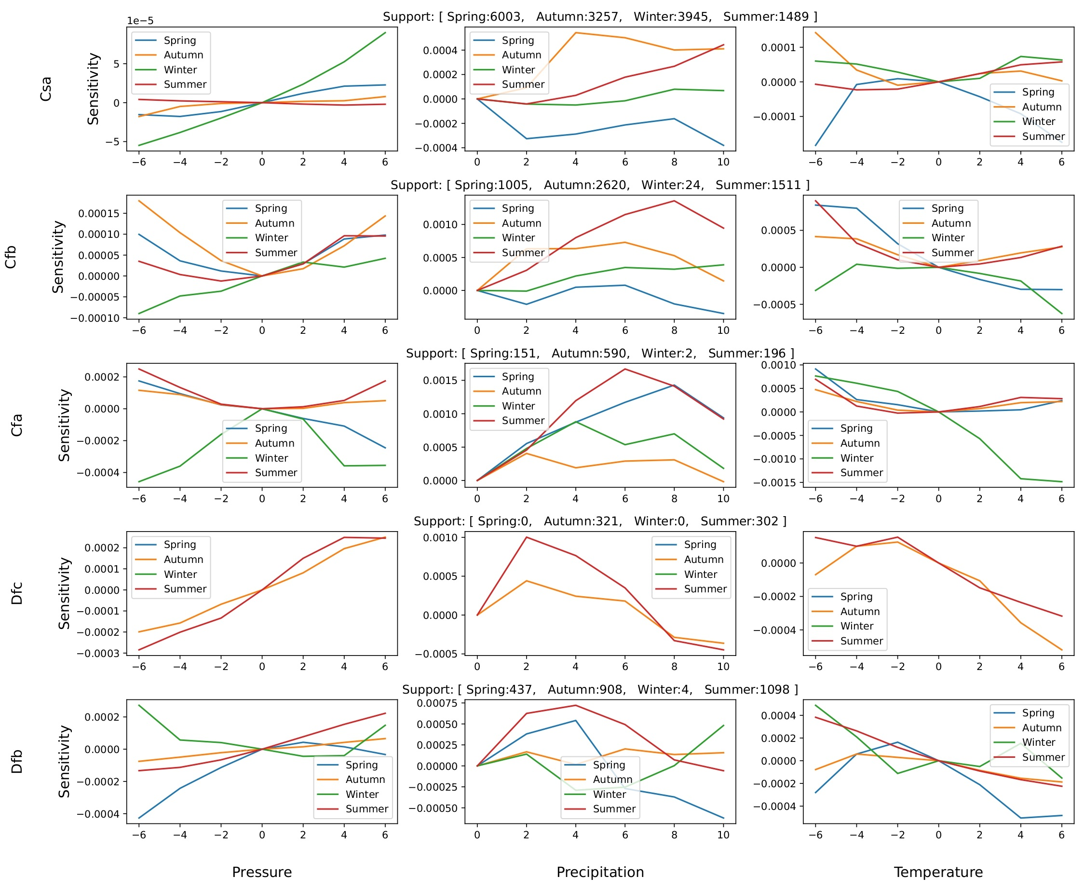
Illustrates the correlation curves of a specific meteorological variable across different seasons, high- lighting seasonal variations in sensitivity patterns

Slide 61
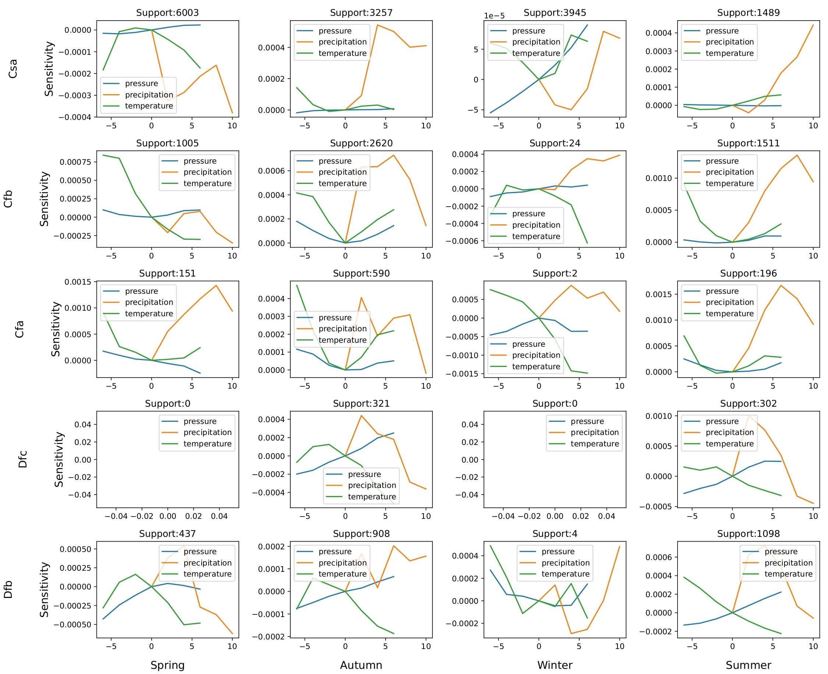
presents the correlation curves of various meteorological variables within a single season, offering in- sights into their interdependence and relative influence during that period.

Slide 62
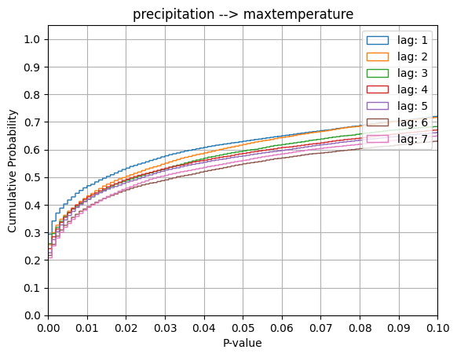
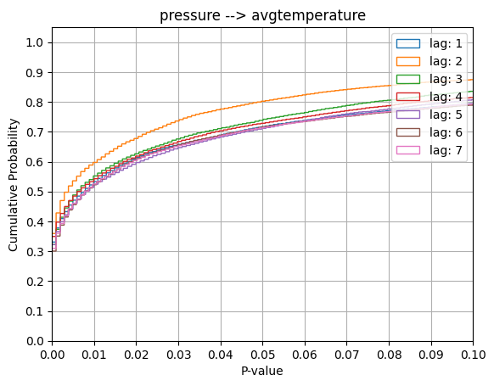
Limitations
We assume feature independence, which may not hold in practice. Future work will include causal inference tests to identify correlated predictors, enabling more informed perturbations and isolating true meteorological variable sensitivity.
The figure illustrates Granger causality relationships across the dataset:
Precipitation → Max Temperature: Approximately 64% of samples exhibit a p-value ≤ 5%.
Pressure → Avg Temperature: Around 80% of samples have a p-value ≤ 5%,
Both suggesting stronger causal association.
This insight emphasizes the importance of accounting for these dependencies in modeling efforts, as they could significantly influence predictions and variable sensitivity analyses.

Slide 63
Limitations
Training disentanglement blocks can be challenging.
Clustering-based recursive segmentation requires temporal clustering after each split, makes it computationally expensive.
Quality of temporal clusters depends upon the choice of clustering technique, metric and other hyperparameters.
Reproducibility can be difficult since unsupervised clustering in involved.
Segmentation granularity depends on GCS threshold which is set manually, this may lead to over-segmentation or under-segmentation.

Slide 64
Future Work
Scalability Enhancements: Developing computationally efficient implementations of CSP.
Broader Applicability Across Domains: Adapting CSP for other high-dimensional, structured datasets, such as biomedical imaging, financial time series, and autonomous navigation, to expand its impact beyond land surface forecasting.
Robust Latent Feature Supervision: Introducing self-supervised learning objectives or domain-informed constraints within the disentanglement framework to improve alignment between latent features and real-world phenomena.
Mitigating Feature Independence: Granger causality can enable more informed perturbations, isolating the true sensitivity of meteorological variables while accounting for potential interdependencies, leading to more accurate and meaningful sensitivity values.

Slide 65
THANK-YOU

Slide 66
References
[1] M. Shokr and Y. Ye, “Why does arctic sea ice respond more evidently than antarcticsea ice to climate change?,” Ocean-Land-Atmosphere Research, vol. 2, p. 0006, 2023.
[2] S. Lampe, C. Burton, E. Burke, J. Chang, N. Christidis, M. Forrest, L. Gudmunds-son, H. Huang, S. Hantson, A. Ito, et al., “The effect of climate change on globalwildfire activity,” in EGU General Assembly Conference Abstracts, pp. EGU–14756,2023.
[3] D. Geudtner, R. Torres, P. Snoeij, M. Davidson, and B. Rommen, “Sentinel-1 sys-tem capabilities and applications,” in 2014 IEEE Geoscience and Remote SensingSymposium, pp. 1457–1460, IEEE, 2014.
[4] M. Beyer, R. Ahmad, B. Yang, and P. Rodr´ıguez-Bocca, “Deep spatial-temporalgraph modeling for efficient ndvi forecasting,” Smart Agricultural Technology, vol. 4,p. 100172, 2023.
[5] F. van Oorschot, R. van der Ent, M. Hrachowitz, E. di Carlo, F. Catalano, S. Bous-setta, G. Balsamo, and A. Alessandri, “Improving the temporal and spatial vege-tation variability in land surface models based on satellite observations,” in EGUGeneral Assembly Conference Abstracts, pp. EGU–6528, 2023.
[6] E. Chrysanthopoulos, C. Pouliaris, I. Tsirogiannis, and A. Kallioras, “Forecastingsoil moisture on a spatial and temporal scale using machine learning algorithms,” inEGU General Assembly Conference Abstracts, pp. EGU–11925, 2023.

Slide 67
References
[7] Y. Zhang, F. Huang, L. Li, Q. Li, Y. Zhang, and W. Shangguan, “Real-time fore-cast of smap l3 soil moisture using spatial–temporal deep learning model with dataintegration,” Remote Sensing, vol. 15, no. 2, p. 366, 2023.
[8] M. Witjes, L. Parente, C. J. van Diemen, T. Hengl, M. Landa, L. Brodsk`y,L. Halounova, J. Kriˇzan, L. Antoni´c, C. M. Ilie, et al., “A spatiotemporal ensem-ble machine learning framework for generating land use/land cover time-series mapsfor europe (2000–2019) based on lucas, corine and glad landsat,” PeerJ, vol. 10,p. e13573, 2022.
[9] J. Wang, X. Yin, S. Liu, and D. Wang, “Spatiotemporal change and predictionof land use in manasi region based on deep learning,” Environmental Science andPollution Research, vol. 30, no. 34, pp. 82780–82794, 2023.
[10] M. T. Ribeiro, S. Singh, and C. Guestrin, “” why should i trust you?” explaining thepredictions of any classifier,” in Proceedings of the 22nd ACM SIGKDD internationalconference on knowledge discovery and data mining, pp. 1135–1144, 2016.
[11] J. H. Friedman, “Greedy function approximation: a gradient boosting machine,”Annals of statistics, pp. 1189–1232, 2001.
[12] A. Habib, C. Karmakar, and J. Yearwood, “Interpretability and optimisation of con-volutional neural networks based on sinc-convolution,” IEEE Journal of Biomedicaland Health Informatics, vol. 27, no. 4, pp. 1758–1769, 2022.27 Computer Vision and Pattern Recognition,pp. 1362–1371, 2022.

Slide 68
References
[13] L. A. De la Fuente, M. R. Ehsani, H. V. Gupta, and L. E. Condon, “Towardsinterpretable lstm-based modelling of hydrological systems,” Hydrology and EarthSystem Sciences Discussions, vol. 2023, pp. 1–36, 2023.
[14] T. Rojat, R. Puget, D. Filliat, J. Del Ser, R. Gelin, and N. D´ıaz-Rodr´ıguez, “Ex-plainable artificial intelligence (xai) on timeseries data: A survey. arxiv 2021,” arXivpreprint arXiv:2104.00950, 2021.
[15] X. Huang, X. Li, Y. Ye, S. Feng, C. Luo, and B. Zhang, “On understanding ofspatiotemporal prediction model,” IEEE Transactions on Circuits and Systems forVideo Technology, 2022.
[16] M. Duckham, J. Gabela, A. Kealy, M. Khan, J. Legg, B. Moran, S. K. Rumi, F. D.Salim, S. Sharmeen, Y. Tao, et al., “Explainable spatiotemporal reasoning for geospa-tial intelligence applications,” Transactions in GIS, vol. 26, no. 6, pp. 2455–2479,2022.
[17] Y. Wang, “Interpretable and scalable graphical models for complex spatio-temporalprocesses,” arXiv preprint arXiv:2301.06021, 2023.
[18] A.-D. Pham, A. Kuestenmacher, and P. G. Ploeger, “Tsem: Temporally-weightedspatiotemporal explainable neural network for multivariate time series,” in Futureof Information and Communication Conference, pp. 183–204, Springer, 2023.

Slide 69
References
[19] C. Requena-Mesa, V. Benson, M. Reichstein, J. Runge, and J. Denzler, “Earth-net2021: A large-scale dataset and challenge for earth surface forecasting as a guidedvideo prediction task.,” in Proceedings of the IEEE/CVF Conference on ComputerVision and Pattern Recognition, pp. 1132–1142, 2021.
[20] M. Haylock, N. Hofstra, A. Klein Tank, E. Klok, P. Jones, and M. New, “A europeandaily high-resolution gridded data set of surface temperature and precipitation for1950–2006,” Journal of Geophysical Research: Atmospheres, vol. 113, no. D20, 2008.
[21] X. Shi, Z. Chen, H. Wang, D.-Y. Yeung, W.-K. Wong, and W.-c. Woo, “Convo-lutional lstm network: A machine learning approach for precipitation nowcasting,”Advances in neural information processing systems, vol. 28, 2015.
[22] C.-A. Diaconu, S. Saha, S. G¨unnemann, and X. X. Zhu, “Understanding the role ofweather data for earth surface forecasting using a convlstm-based model,” in Pro-ceedings of the IEEE/CVF Conference on

